Slide 1
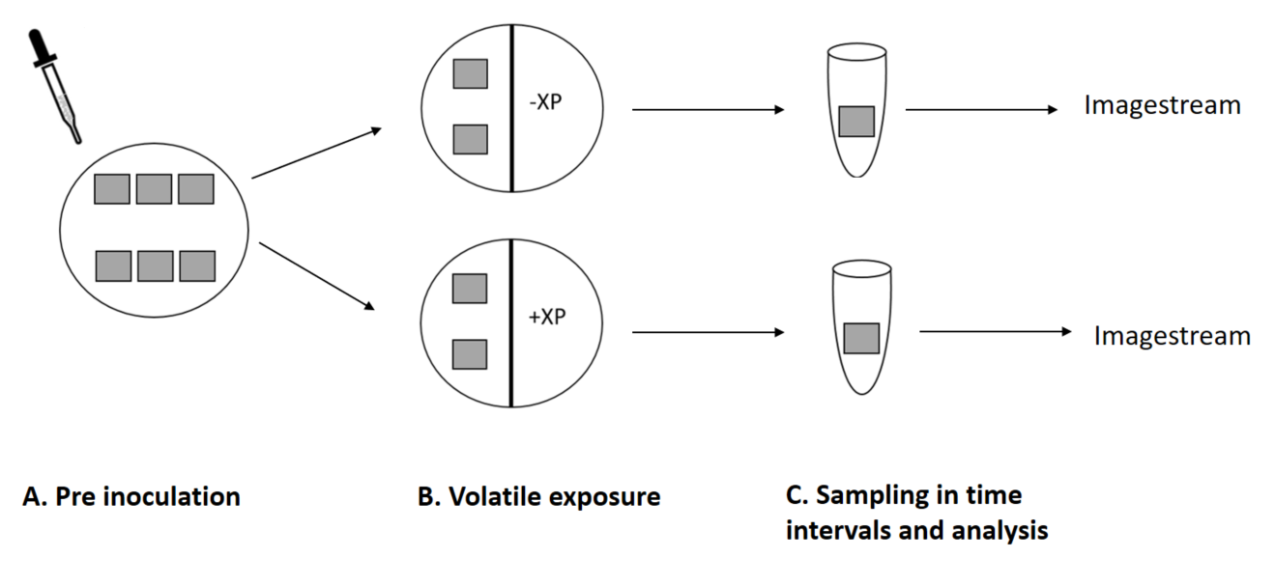
(A). Agar pads were inoculated with XP and incubated for 12 h. until the reached the peak of their elongation process. (B). Once they reached the peak, the pads with intact colonies were transfer to a bi-partite plate that half of the agar in it was already pre-conditioned 36 h in advance with XP volatiles (Xp was grown on the opposing partition) . (C). sampling in different time intervals by harvesting agar pads in to fixation buffer and subsequently analysis in image stream

Slide 2
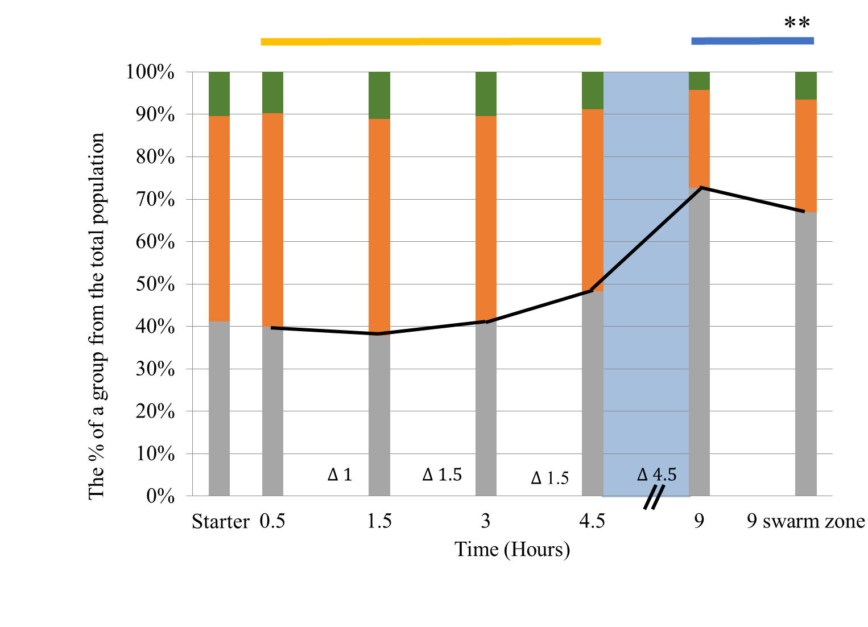
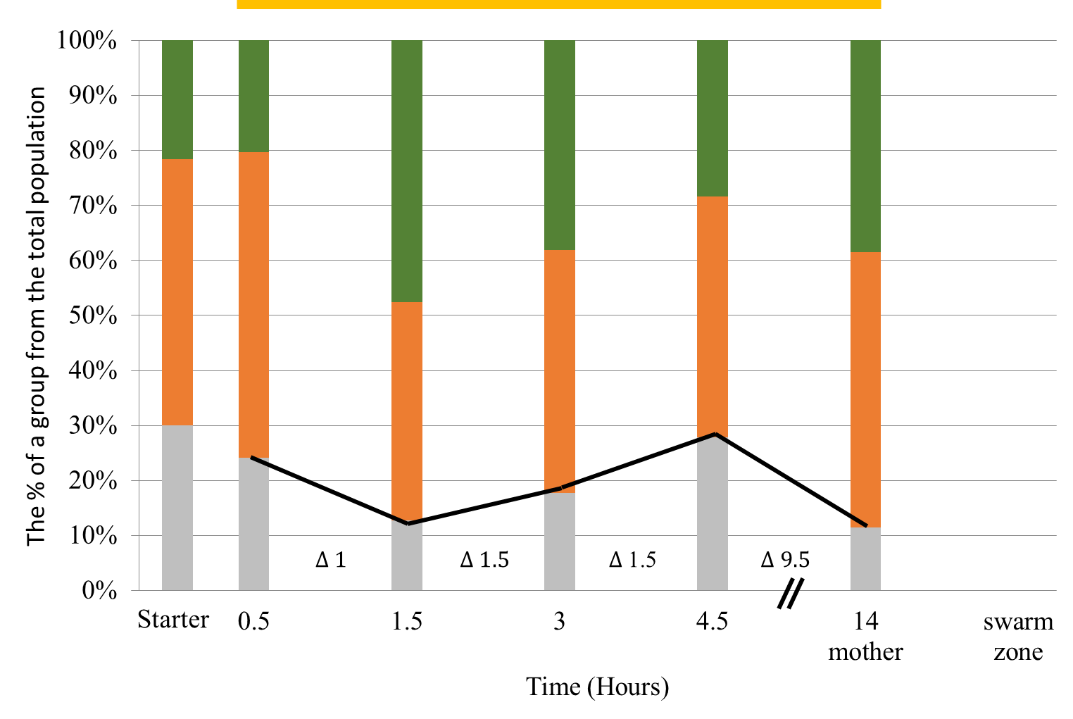
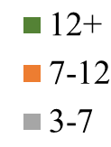
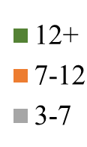
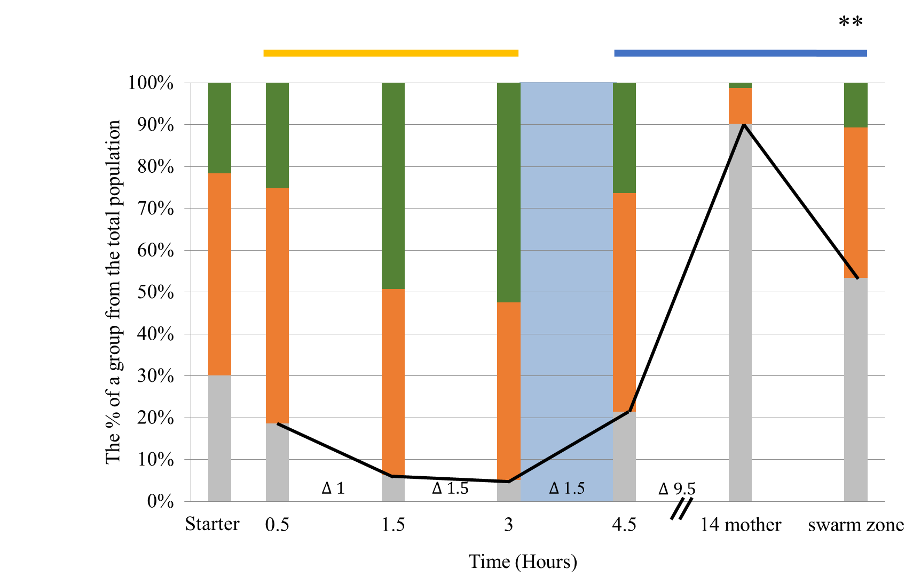
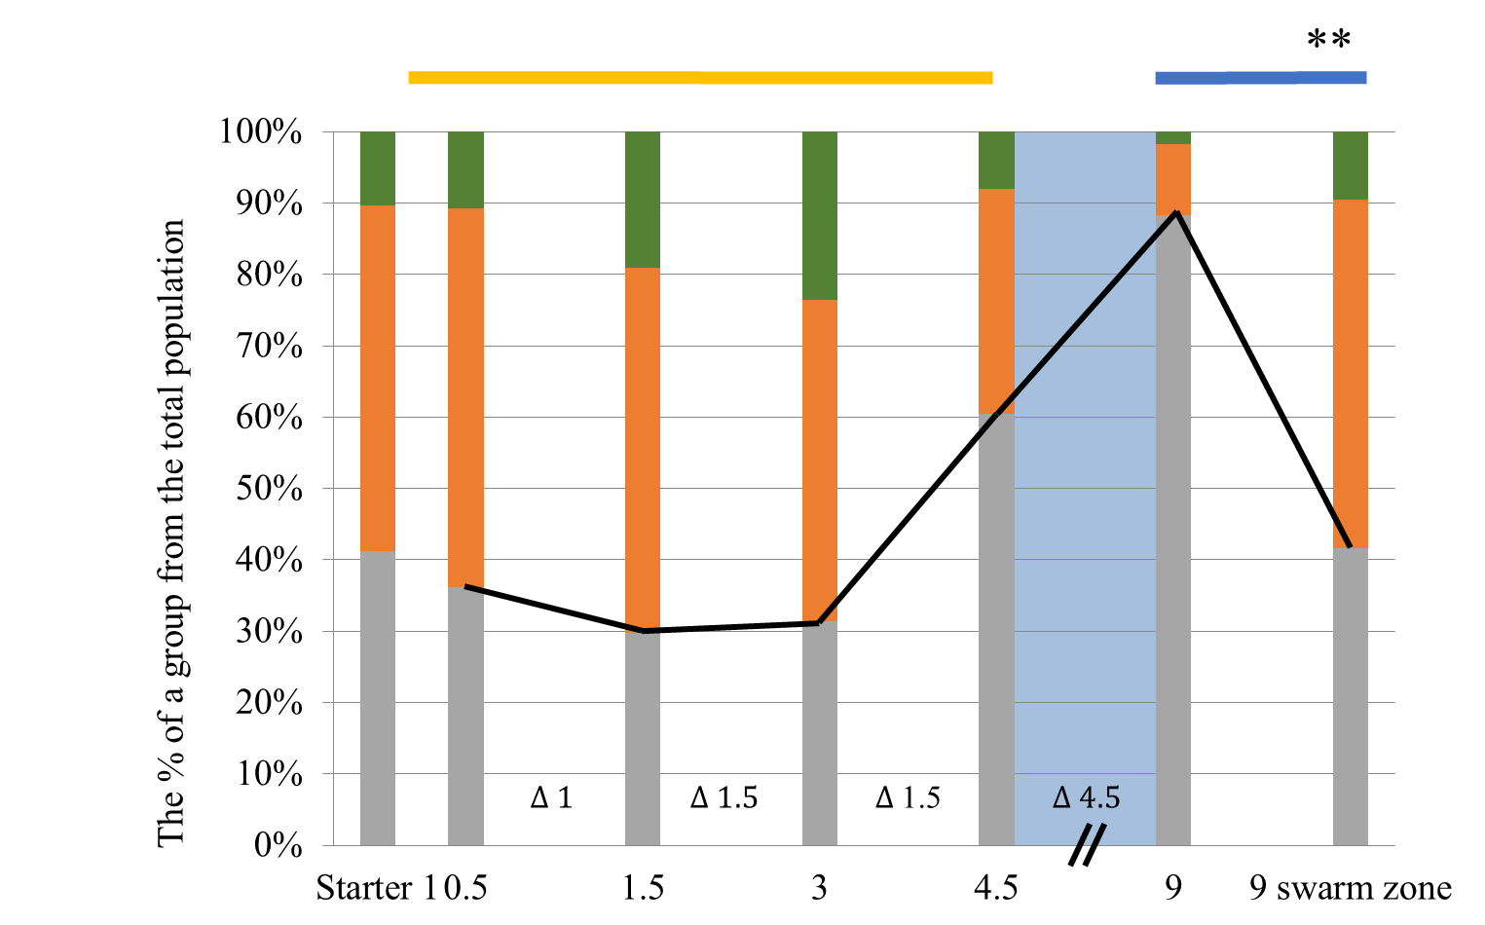

A
C
A
Mid-elongation
FINAL PLOT
14 h
mother
9 h
mother
Swarm zone
B
D
14 h
mother
9 h
mother
Swarm zone

